Slide 1

Kubo introduction

Slide 2
Kubo
BOSH release to manage Kubernetes deployments
Deploys and manager K8s clusters with BOSH
Provides high availability
Manages password and certificate generation inside the clusters
Notes:
goal:
single platform for all devices
Increase quality and reduce the amount of stabilization
reduce planning.
PaaS is good fit for Project automatization
tests should be small.

Slide 3
Kubo Components

Slide 4
Components: Kubernetes
Automated deployment of containers
Manage containerized workloads
Self healing:
Provides:
Auto placement
Auto restart
Auto replication
Auto scaling
Extensible: add plugins, modules.
Deploy anywhere: public cloud, private cloud, hybrid clouds.
Notes:
goal:
single platform for all devices
Increase quality and reduce the amount of stabilization
reduce planning.
PaaS is good fit for Project automatization
tests should be small.

Slide 5
Components: KuBOSH
BOSH director plus:
CredHub
PowerDNS
UAA
Notes:
goal:
single platform for all devices
Increase quality and reduce the amount of stabilization
reduce planning.
PaaS is good fit for Project automatization
tests should be small.

Slide 6
Kubo Networking Topology

Slide 7
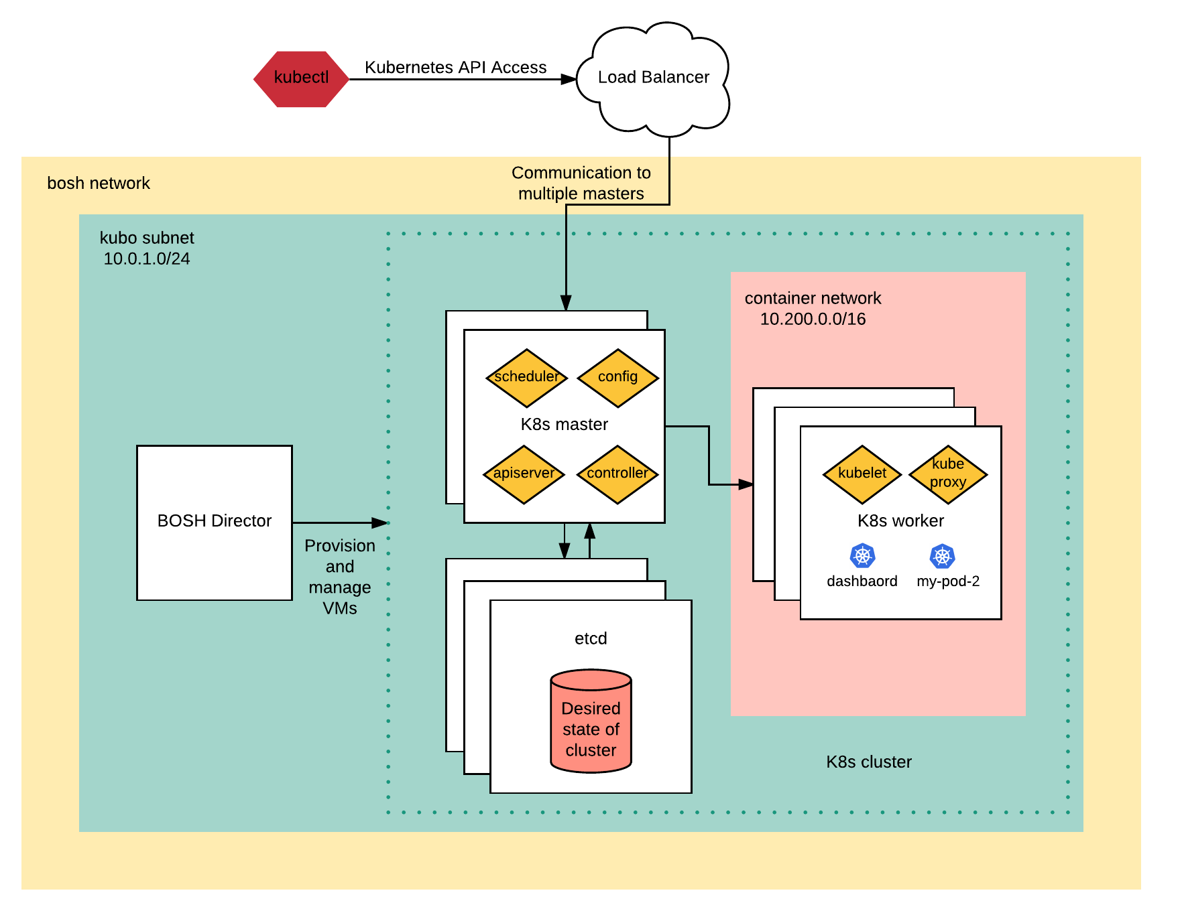
Using IaaS LBs
K8s API is exposed on an specific IaaS LB, associated with an external static IP address
K8s can be exposed using a second LB with a forward rule to the worker nodes

Slide 8
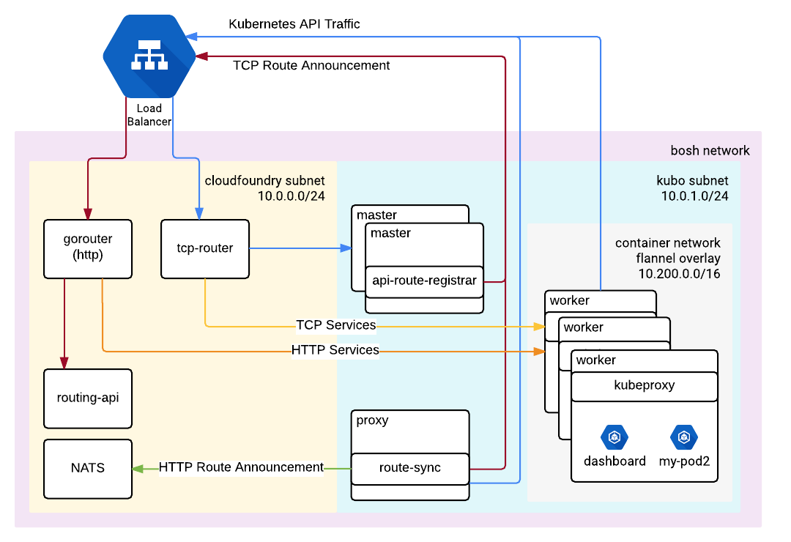
Using Cloud Foundry
K8s API nodes register with CF’s tcp-router.
All traffic to K8s API nodes goes through the tcp-router
The tcp-router acts as the public and internal endpoint
CF and Kubo’s subnets should be able to communicate between them.

